Slide 1


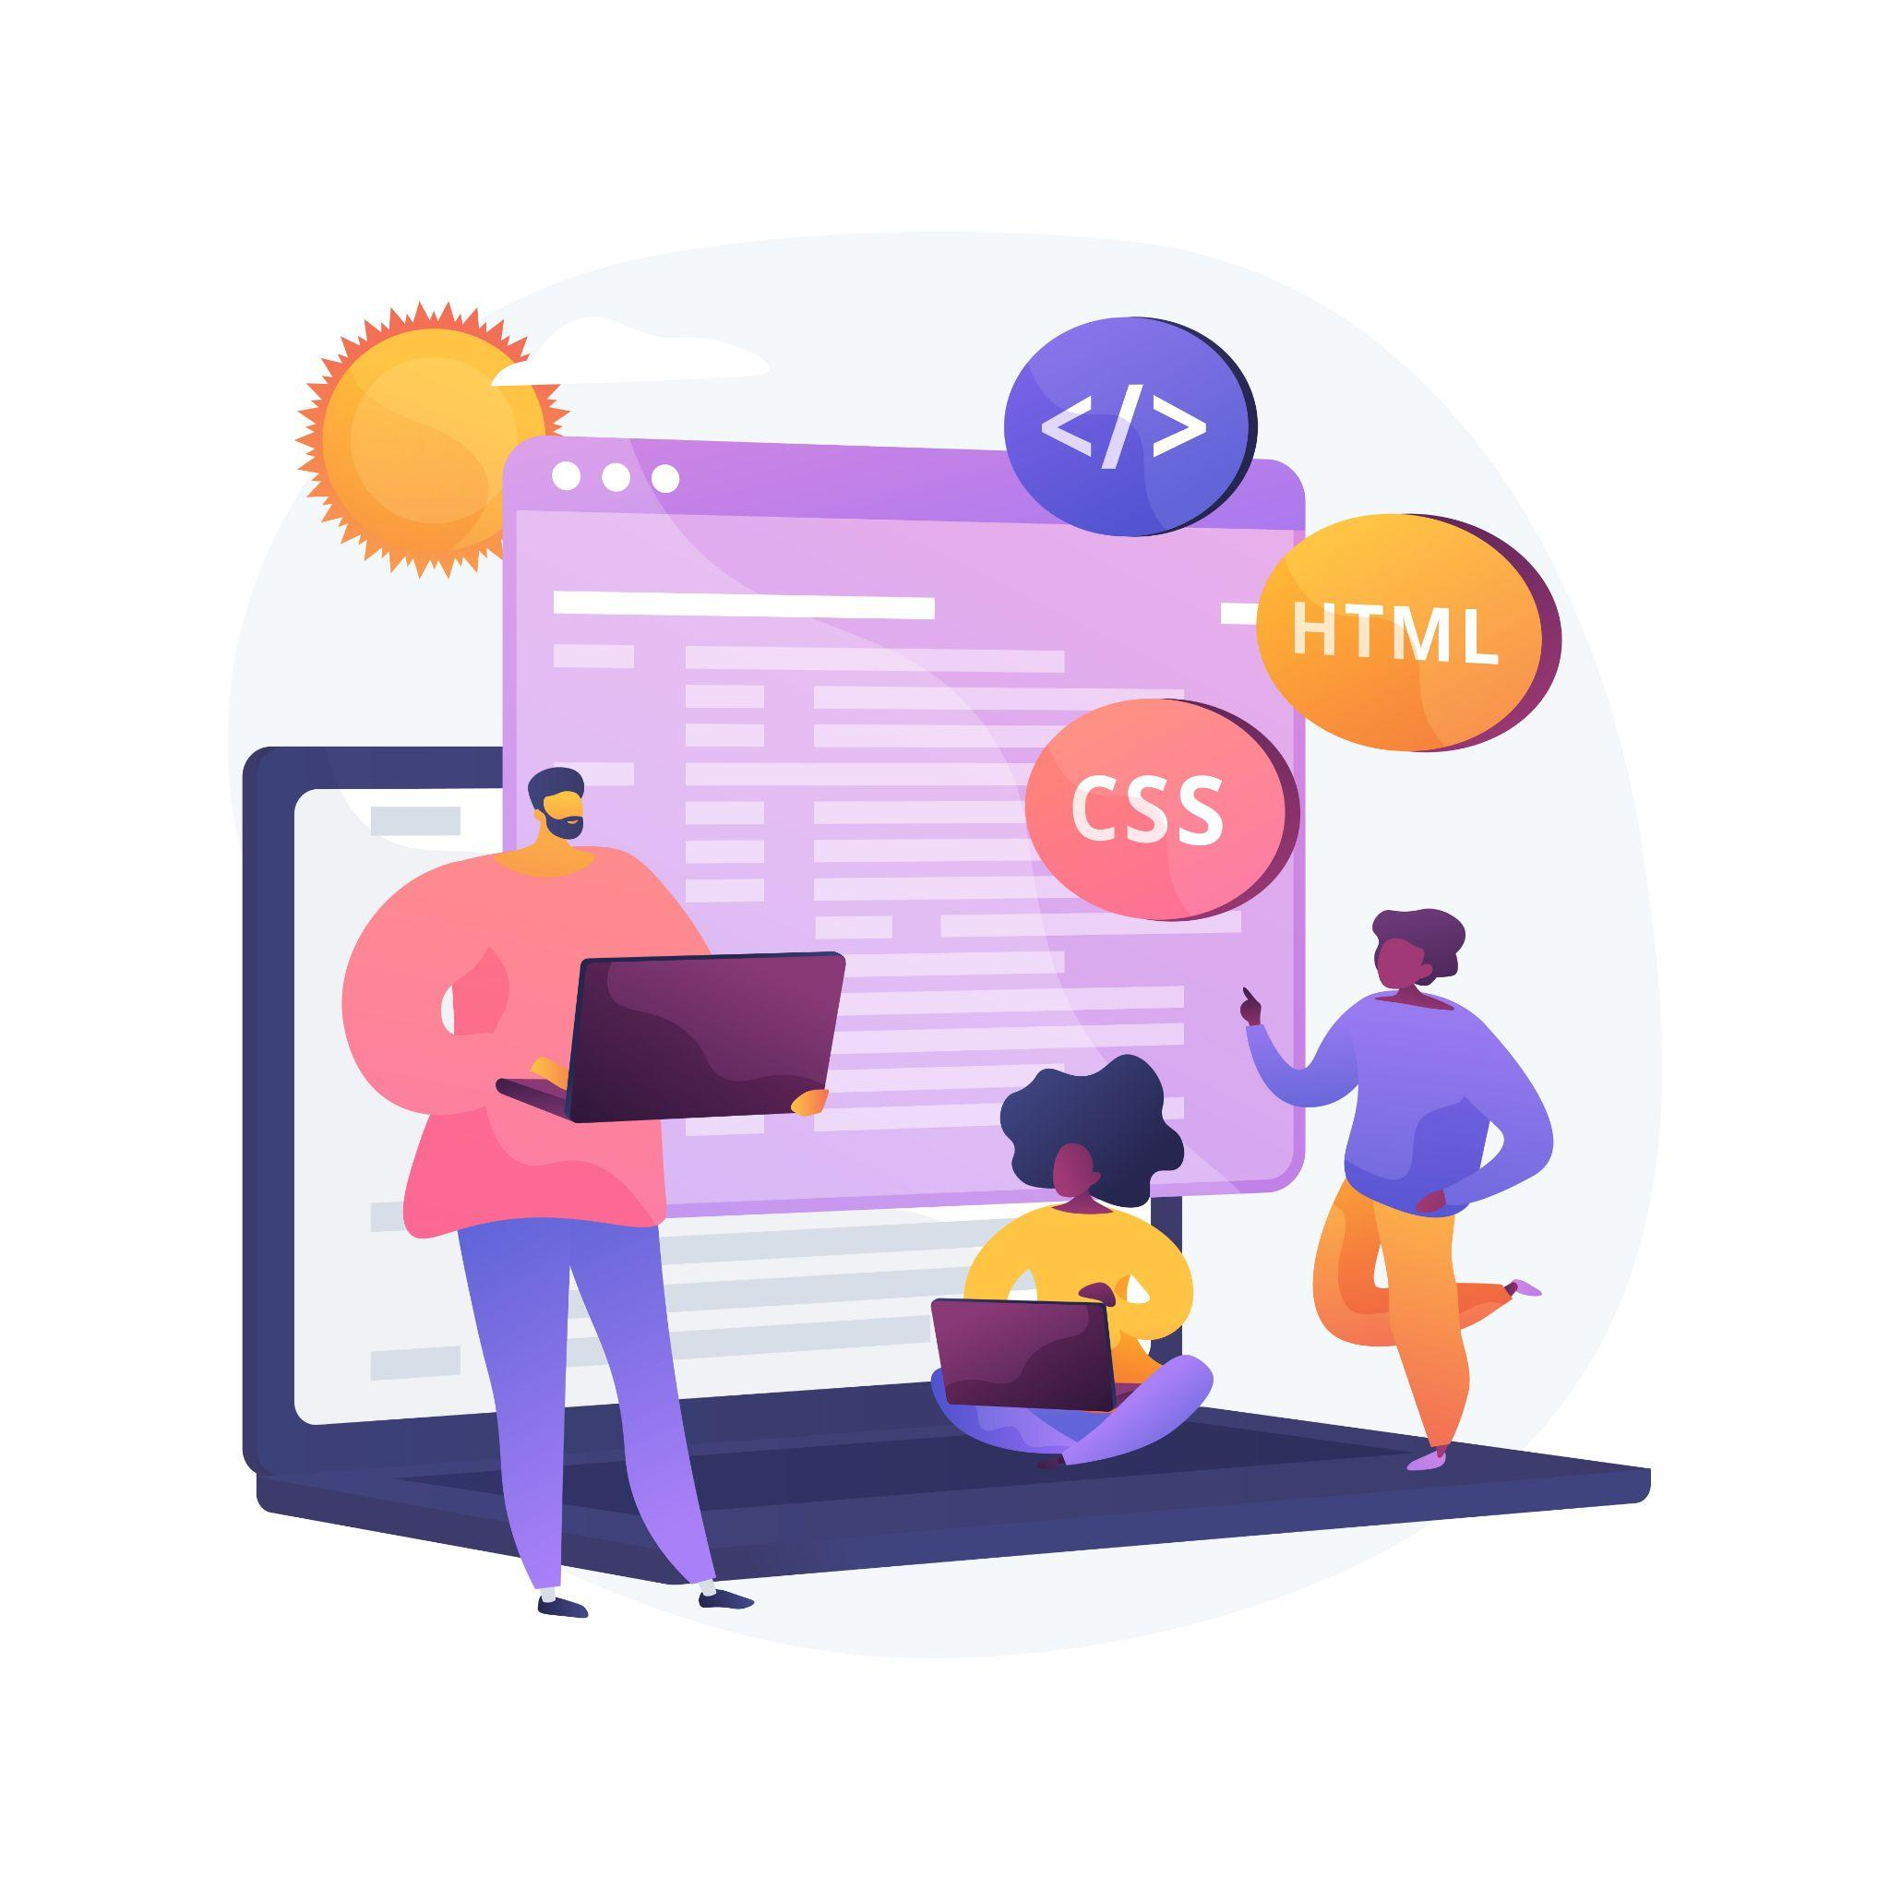



Lecture 5:
Event Handling Basics
Course - Web Development - II
-By
Instructor Name
welcome@krmangalam.edu.in
Sohna Road,Gurugram,Haryana 122103

Slide 2

| Table of Contents
addEventListener()
removeEventListener().
Event object
References.
The End.

Slide 3

|
You're sitting comfortably at home. You’re not randomly opening the door every minute, right?
So how do you know when to open it?

Slide 4
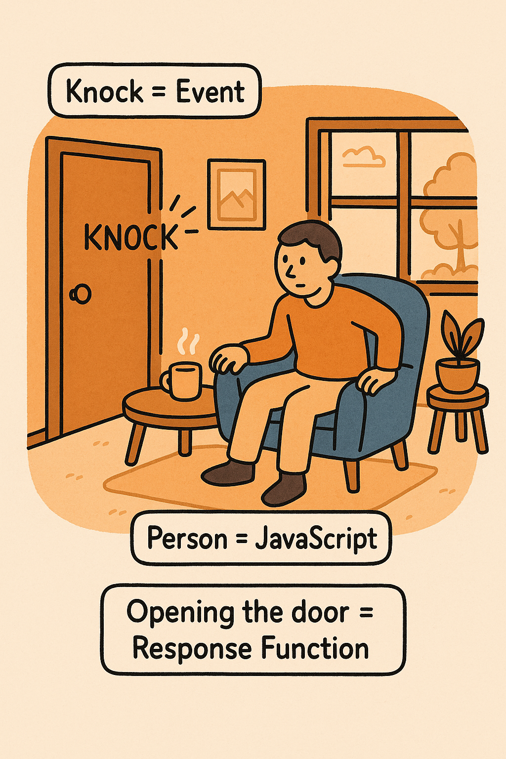
|
You're sitting comfortably at home. You’re not randomly opening the door every minute, right?
So how do you know when to open it?
You wait until someone knocks.
The knock is your signal — only when you hear it, you get up and open the door.
Now think of JavaScript…
Just like you listen for a knock, JavaScript can listen for events like clicks, scrolls, or keypresses.
When the event happens, it runs a function in response — just like opening the door when someone knocks.

Slide 5
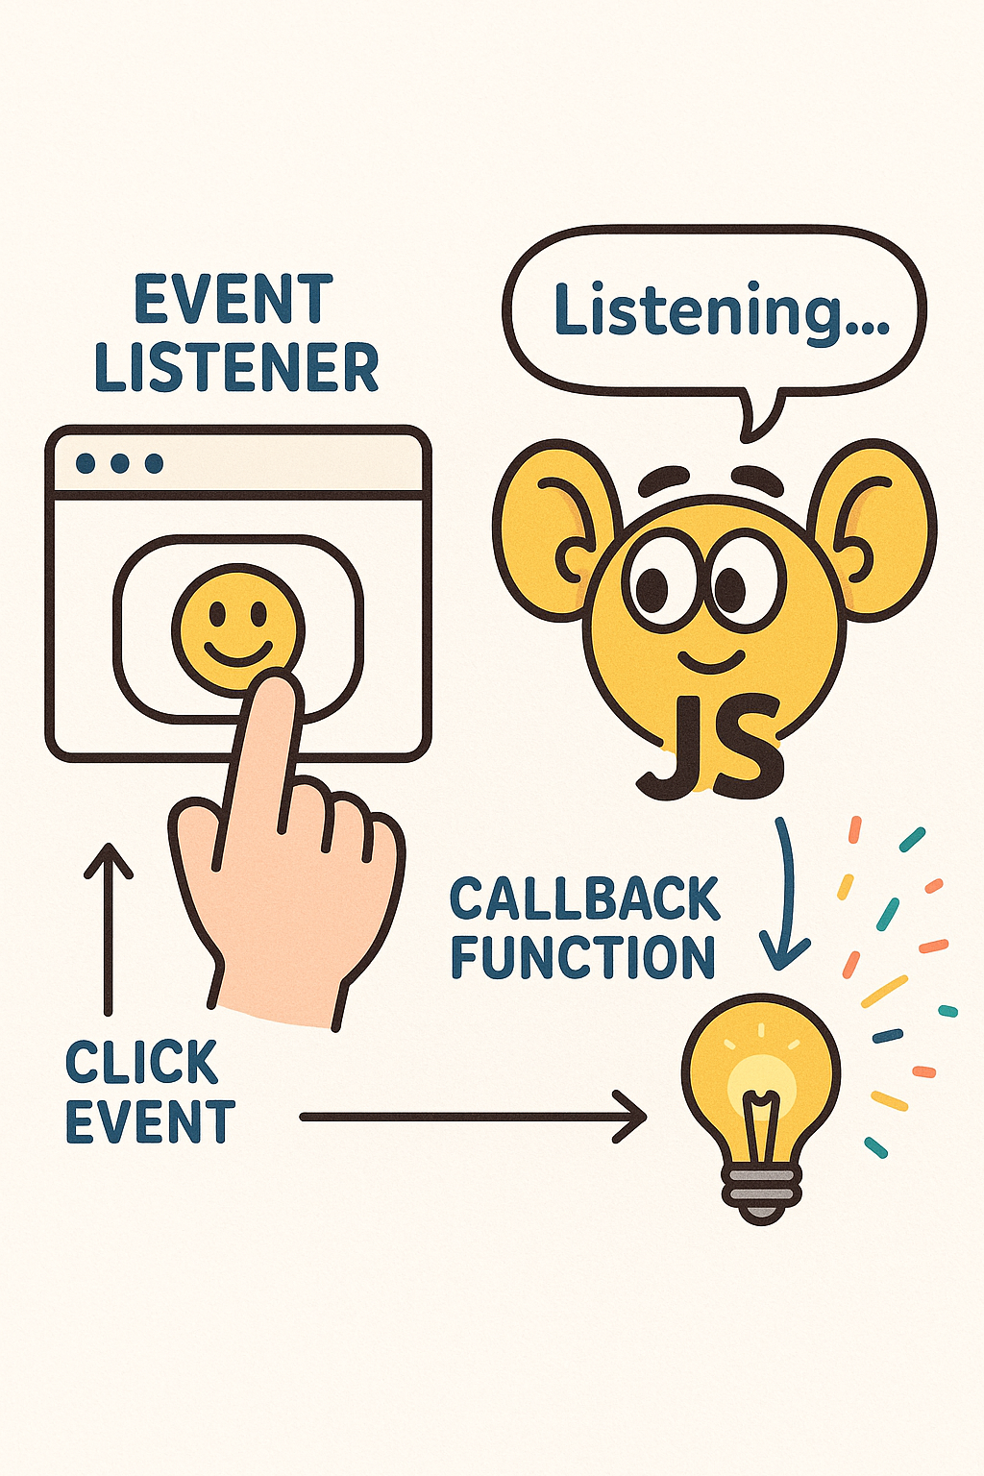
| Event Listeners
An event listener is a way to make your web page react to user actions like clicking, typing, hovering, scrolling, etc.
It “listens” for a specific event on an element, and when that event happens, it runs the function (or code) you tell it to.
We use a special built-in method called addEventListener() to add a listener to any element on the page.

Slide 6
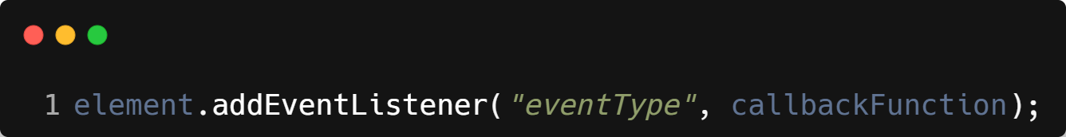
| addEventListener()
.addEventListener() is a built-in JavaScript method that lets you listen for specific events (like clicks, keypresses, mouse movements, etc.) on an element — and then run some code when that event happens.
Syntax :
element – The HTML element you want to attach the listener to.
"eventType" – A string like "click", "keydown", "submit", etc.
callbackFunction – The function that runs when the event happens.

Slide 7
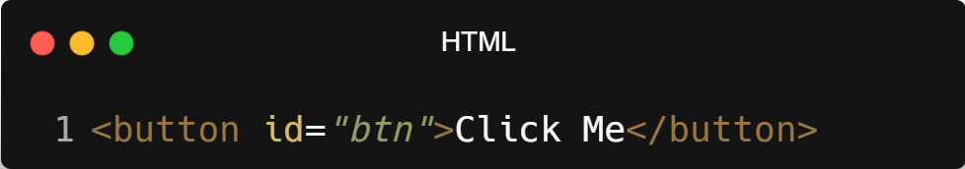
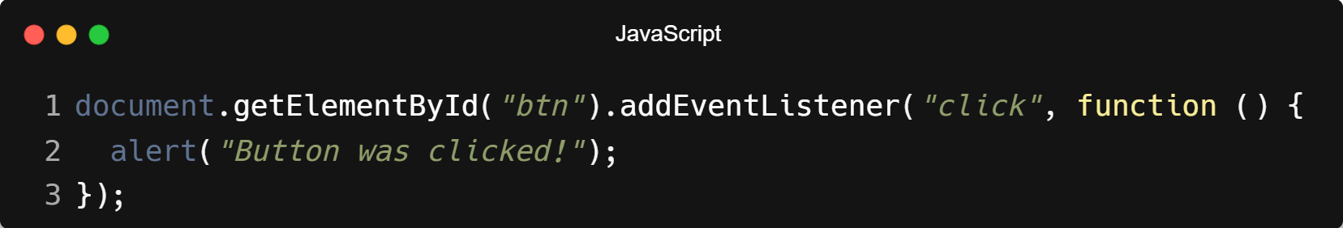
| addEventListener()
Example :

Slide 8
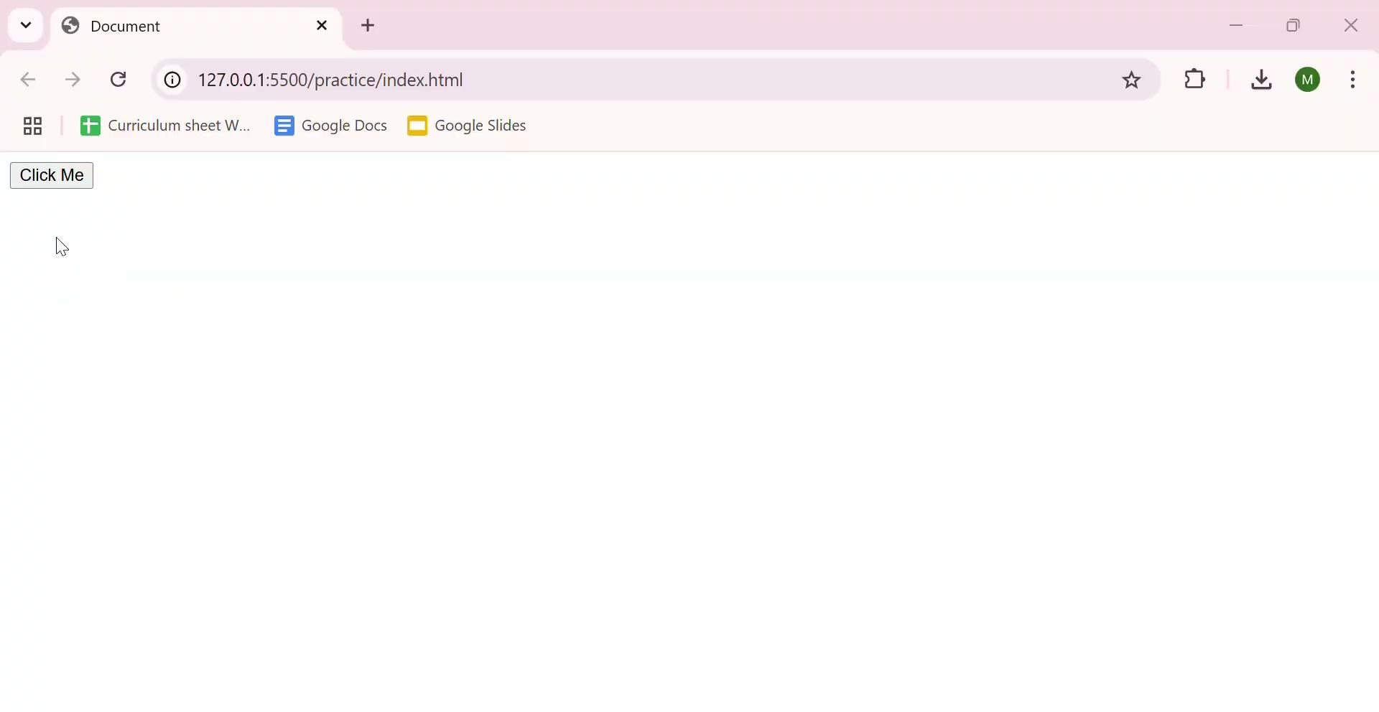
| addEventListener()
Output :

Slide 9
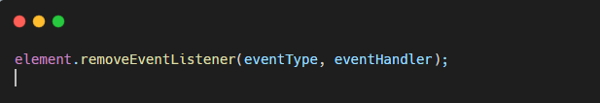
| removeEventListener()
removeEventListener() is used to remove a previously attached event listener from an element. This is useful when an event handler is no longer needed, helping to improve performance and memory management.
The same function reference used in addEventListener() must be passed to remove it.

Slide 10
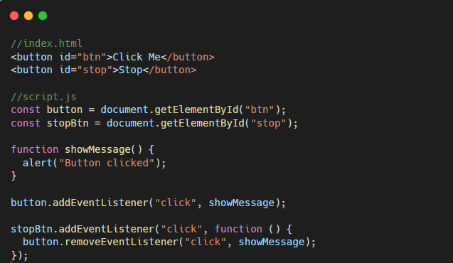
| removeEventListener()
Example
After clicking Stop, the button will no longer respond.

Slide 11
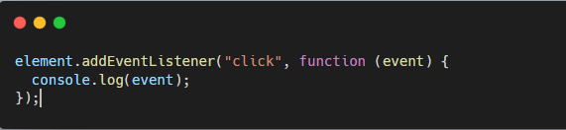
| Event Object
The Event Object is an object automatically passed to the event handler when an event occurs. It contains detailed information about the event such as:
Type of event
Target element
Mouse position
Keyboard key pressed
Default behavior

Slide 12
| Common Properties of Event Object
Property | Description
event.type | Type of event (click, keyup, submit)
event.target | Element that triggered the event
event.currentTarget | Element on which listener is attached
event.clientX | Mouse X position
event.clientY | Mouse Y position
event.key | Key pressed (keyboard events)
event.preventDefault() | Prevents default behavior
event.stopPropagation() | Stops event bubbling

Slide 13
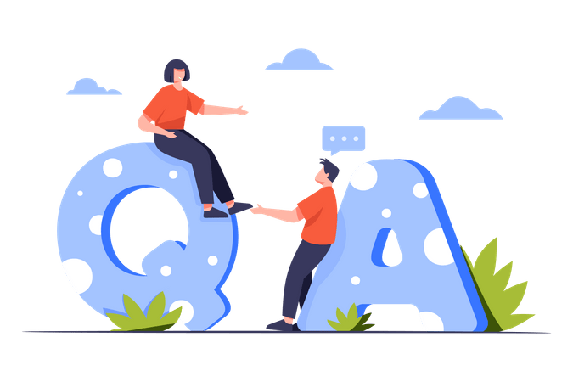
| Check Your Understanding
Question : What are the two most essential arguments passed to the addEventListener()
method?
Options : a) The element and the style to change.
b) The event type (e.g., 'click') and the listener (callback) function to run.
c) The function name and a boolean value.
d) The mouse coordinates and the key that was pressed.
Answer : b) The event type (e.g., 'click') and the listener (callback) function to run.
Explanation:
You must tell addEventListener() what to listen for (the event type string) and what to do when it happens (the listener/callback function).

Slide 14
| References
MDN Web Docs : Comprehensive and official documentation for JS. 🔗https://developer.mozilla.org/en-US/docs/Web/JavaScript
W3Schools – JS Tutorial : Beginner-friendly JS tutorials with examples and interactive editors. 🔗 https://www.w3schools.com/js/
JavaScript.info - A comprehensive tutorial-style website that covers core JavaScript concepts in depth.
🔗https://javascript.info/

Slide 15
Thanks
For
Watching
Course - Web Development - II
welcome@krmangalam.edu.in
Sohna Road,Gurugram,Haryana 122103

